Slide 1
Welcome to Javascript

Slide 2
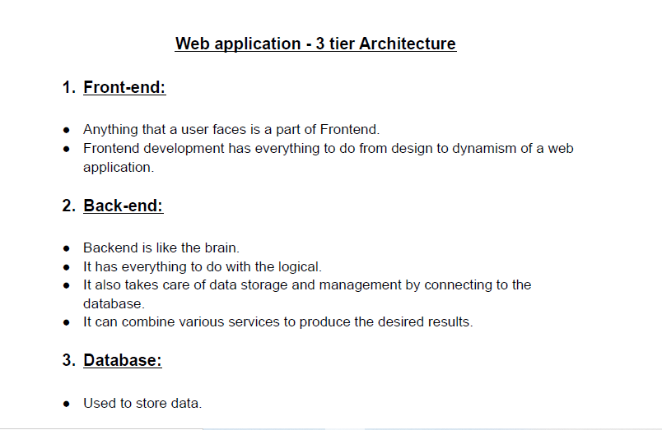
Web Application

Slide 3
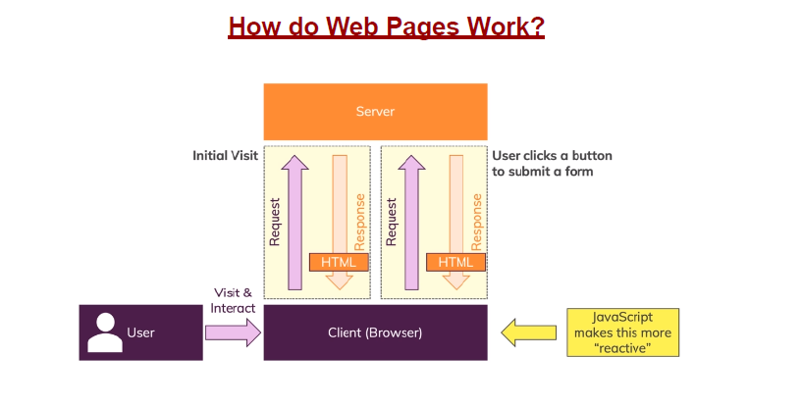
How do Web Pages Work?

Slide 4
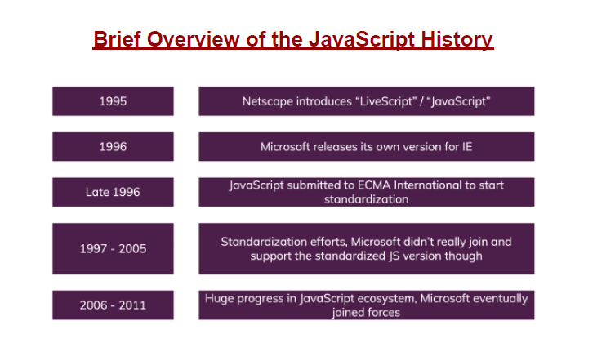
History of Javascript

Slide 5
What is JavaScript?
JavaScript is a client side scripting language (interpreted programming language)
JavaScript make web pages interactive
Open source and cross-platform
Case sensitive
Most commonly used as a part of web pages
JS was created to make web pages more Dynamic (Change content on a page directly from inside the browser)
Supported by all major browsers and enabled by default

Slide 6
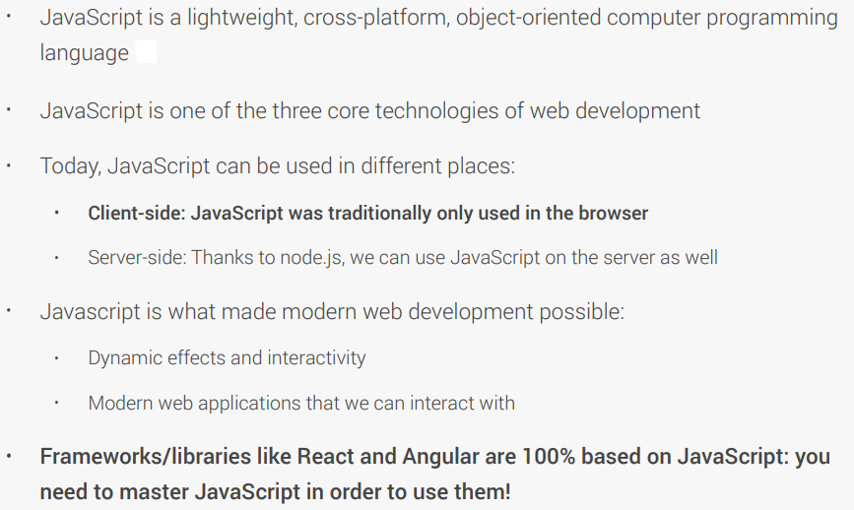
WHAT IS JAVASCRIPT

Slide 7
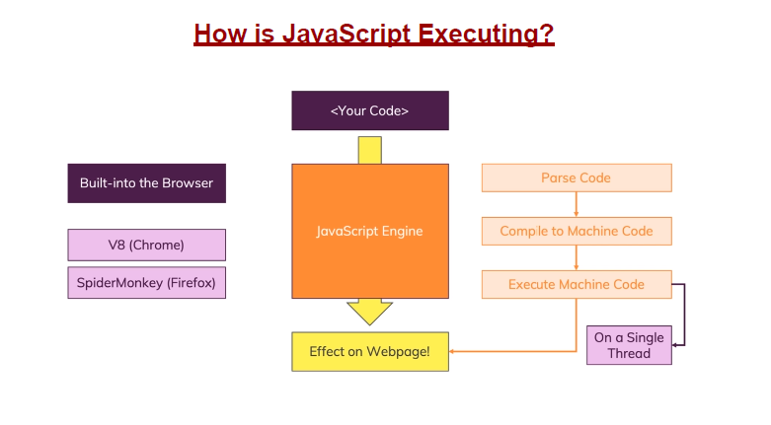
How Javascript Works

Slide 8
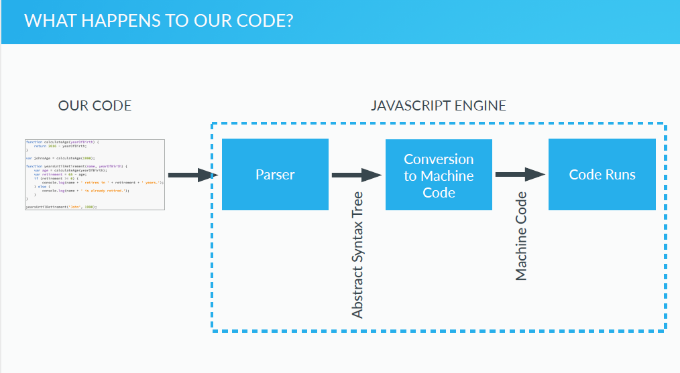
Javascript Engine

Slide 9
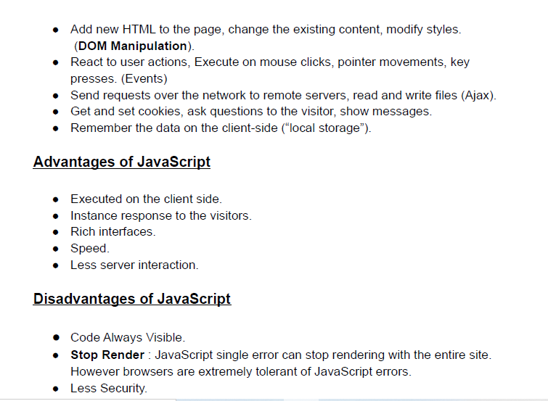
What Javascript Can do?

Slide 10
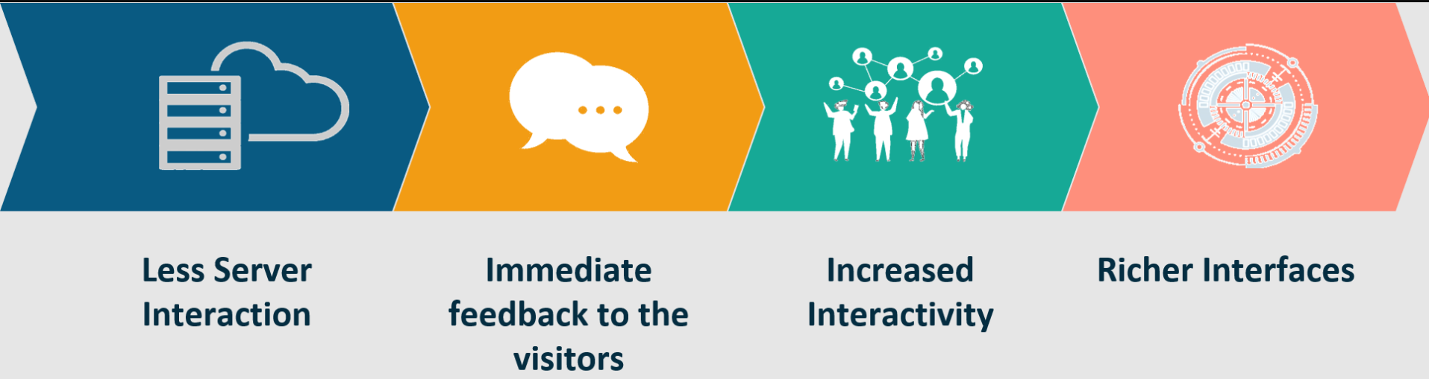
Why JavaScript?
JavaScript adds behavior to web pages
Show or hide more information with the click of a button
Change the color of a button when the mouse hovers over it
Less server interaction
Immediate feedback to the visitors

Slide 11
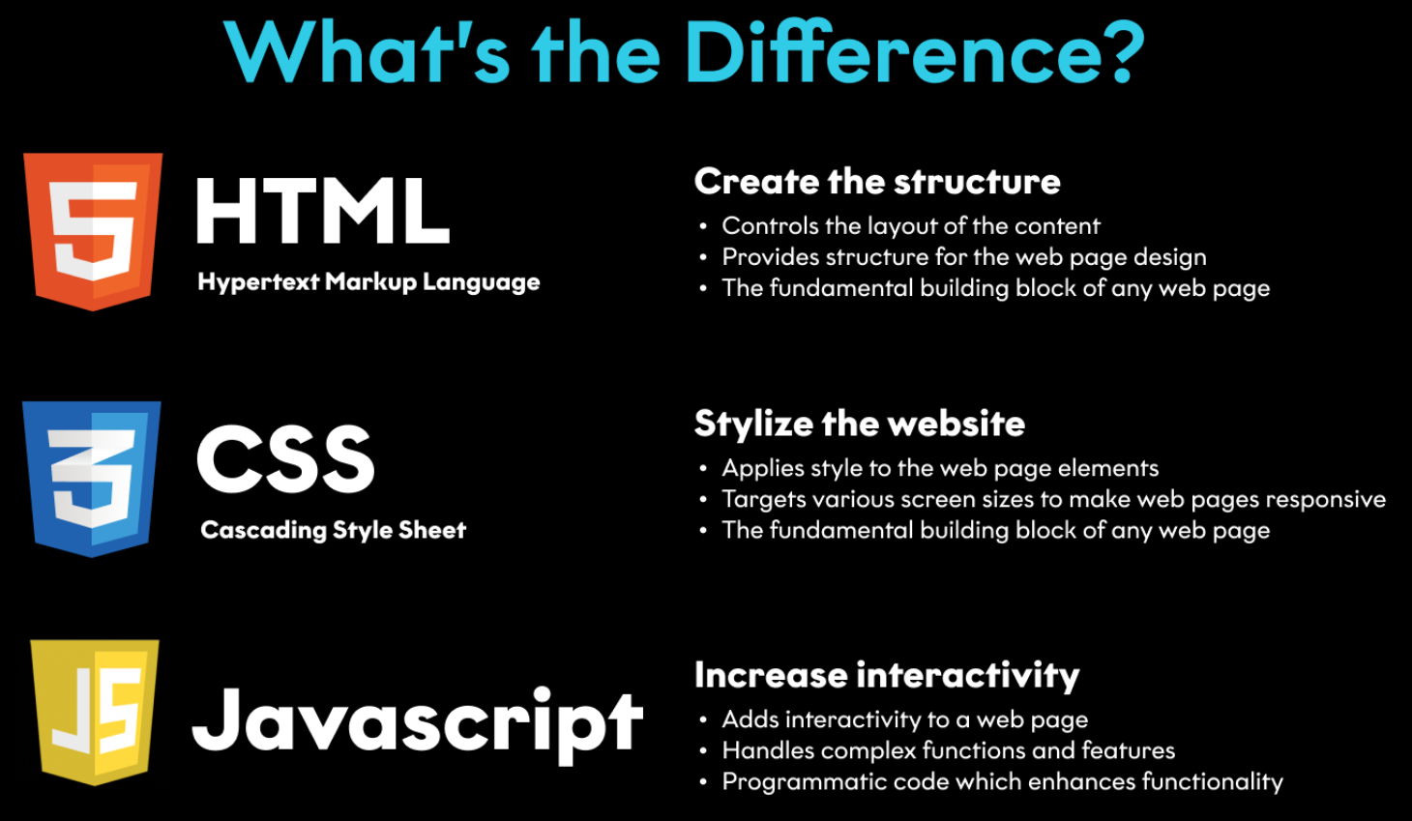
HTML, CSS & JavaScript

Slide 12
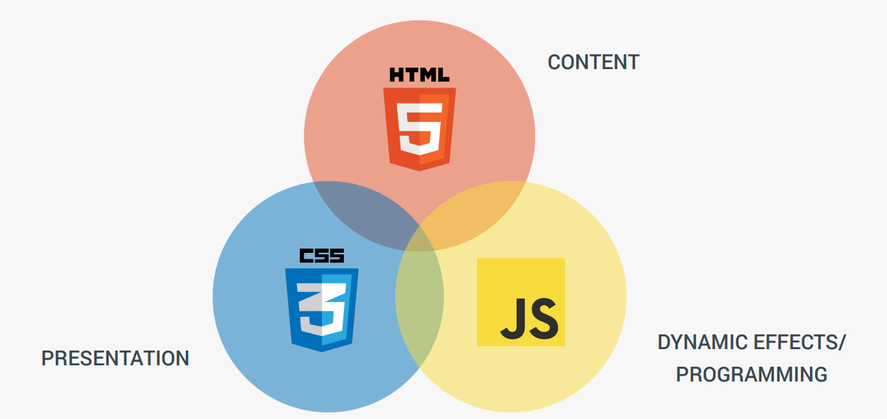
features

Slide 13
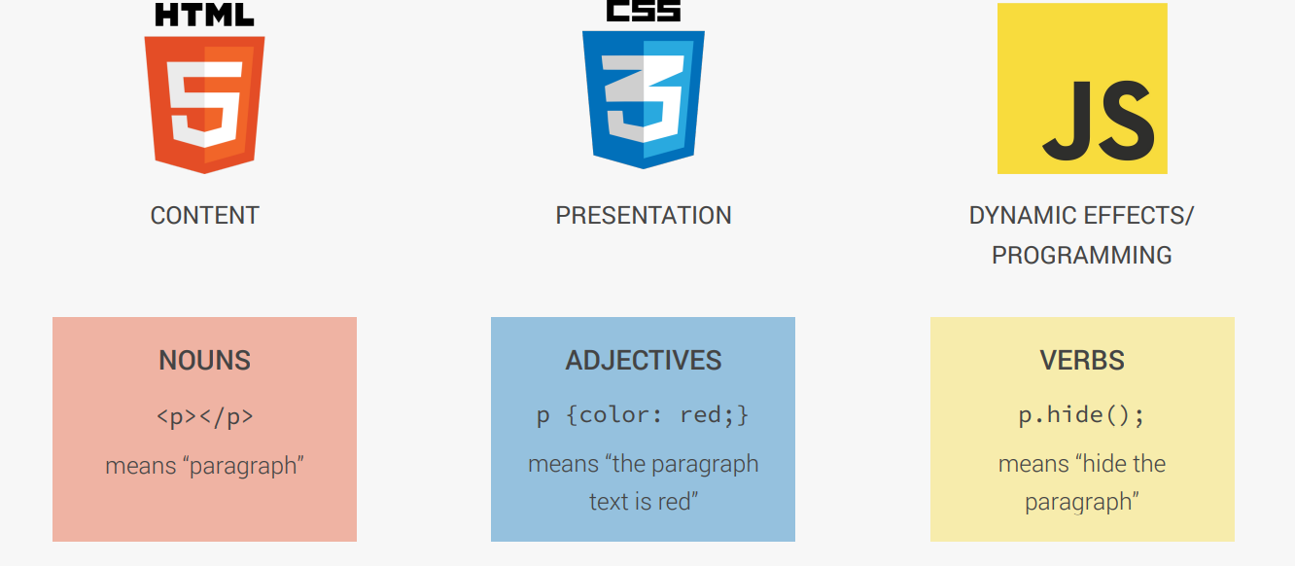
understanding

Slide 14
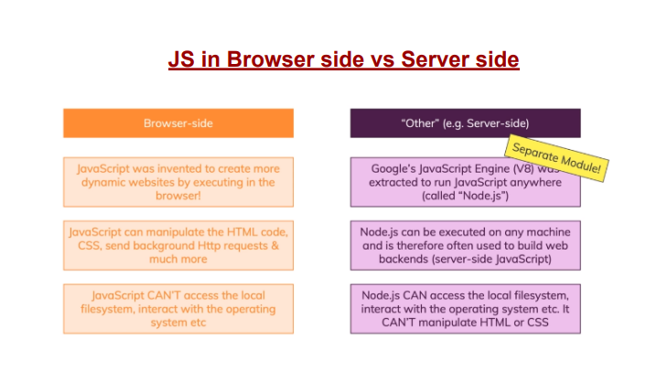

Slide 15
How to Add JavaScript
Internal JS - Internal JavaScript code is code that's placed anywhere within the web page between the HTML tags
External JS
JavaScript code placed in a file separate from the HTML code is called external Javascript.
External JavaScript code is written and used in the same way as internal Javascript.
The file should have the ".js" extension.
<script>
alert("Happy Learning");
</script>
<script src="myScript.js"></script>

